Slide 1
VISIONAID ONE: AN INTELLIGENT WEARABLE COMPANION FOR REAL-TIME PERCEPTION AND INDEPENDENCE OF THE VISUALLY IMPAIRED
GUIDED BY:
Mrs. A.Reeta Joldrine – AP / AI&DS
PRESENTED BY:
Ranchani R (815422104038)
Sandhiya S (815422104045)
Swetha S (815422104057)
Selvarani K (815422104304)

Slide 2
OBJECTIVES
To develop a smart wearable system for visually impaired users.
To provide real-time object detection and voice feedback.
To improve independence and safety in daily life.

Slide 3
ABSTRACT
The proposed system integrates face recognition, obstacle detection, and currency recognition into a single wearable device.
Advanced AI techniques such as the Grassmann model, YOLO, and Convolutional Neural Networks enable accurate real-time audio feedback.
It captures real-time images using a camera.

Slide 4
SCOPE
Provides real-time object and obstacle detection.
Recognizes faces and identifies currency.
Converts visual information into voice output.
Improves independence and safety for visually impaired users.

Slide 5
LITERATURE SURVEY
TITLE | AUTHOR & YEAR | METHODOLOGY | MERIT | DEMERIT
Using object detection technology to identify defects in clothing for blind people | Rocha, Daniel, et al. (2023) | Object Detection | Helps visually impaired identify defects in clothing efficiently | Limited to clothing-related applications, not general-purpose navigation or recognition
Object detection and recognition using TensorFlow for blind people | Darshan A, Mirapure, Pakhamode Dipam, Shirpurkar Rina (2024) | TensorFlow-based Object Detection & Recognition | Assists blind users in recognizing objects in real-time | May have limited accuracy in complex or dynamic environments
Salient object detection for images taken by people with vision impairments | Reynolds, Jarek, Chandra Kanth Nagesh, Danna Gurari (2024) | Salient Object Detection | Improves detection of important objects in images captured by visually impaired users | Requires good image quality; may miss less salient but important objects
Unknown sniffer for object detection: Don't turn a blind eye to unknown objects | Liang, Wenteng, et al. (2023) | Unknown Object Detection | Can detect previously unseen or unknown objects, enhancing safety | Computationally intensive; may produce false positives
Pathfinder: Designing a map-less navigation system for blind people in unfamiliar buildings | Kuribayashi, Masaki, et al. (2023) | Map-less Navigation System | Enables navigation in unknown indoor environments without pre-built maps | Focused only on indoor navigation; does not handle face or currency recognition

Slide 6
LITERATURE SURVEY
TITLE | AUTHOR & YEAR | METHODOLOGY | MERITS | DEMERITS
Distance assessment by object detection for visually impaired assistive mechatronic system | Dragne et al., 2022 | Used deep learning-based object detection combined with distance estimation sensors to assist visually impaired users in identifying obstacles | Provides real-time obstacle detection, improves mobility safety | Requires high processing power, limited performance in low-light conditions
Improve accessibility for low vision and blind people using machine learning and computer vision | Shukurov, 2024 | Applied machine learning and computer vision techniques for object recognition and environmental understanding | Enhances accessibility, adaptable to different environments | Accuracy depends heavily on dataset quality, computationally expensive
Automatic object detection algorithm-based braille image generation system | Lee & Cho, 2022 | Used object detection algorithms to recognize real-life objects and convert them into braille images | Supports tactile learning, improves object recognition | Complex hardware setup, slower response time
LidSonic for visually impaired: assistive smart glasses | Busaeed et al., 2022 | Developed smart glasses using green ML with sensors, Arduino, and mobile app integration | Energy efficient, portable, real-time feedback | Limited detection range, depends on device calibration
Effect of explainable AI on AI-supported decision-making | Janssen et al., 2022 | Studied explainable AI systems through experiments with government decision-makers | Improves trust in AI systems, better transparency | Not directly focused on assistive technology, implementation complexity

Slide 7
EXISTING SYSTEM
White cane and guide dogs.
Smartphone-based apps with limitations.
No continuous real-time perception support.
Face detection systems exist to help visually impaired users identify people.

Slide 8
DISADVANTAGES
Difficulty in accurately identifying different types of objects.
Performance depends on lighting conditions
Requires continuous power supply
Limited detection range

Slide 9
PROPOSED SYSTEM
Smart wearable device with camera and sensors.
Uses deep learning for object detection.
Converts visual information into audio output.

Slide 10
ADVANTAGES
Integrates all functions into a single wearable device.
Real-time assistance
Portable and user-friendly
Reduces dependency on others

Slide 11
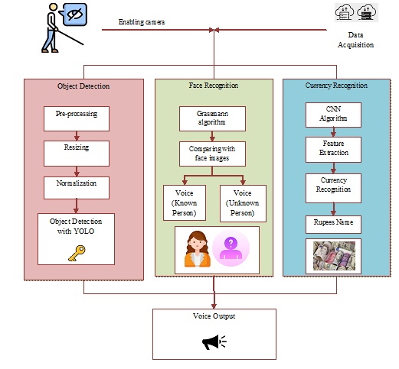
SYSTEM ARCHITECTURE

Slide 12
MODULES LIST
Data Management
Object Detection
Face Recognition
Currency Recognition
Audio Feedback

Slide 13
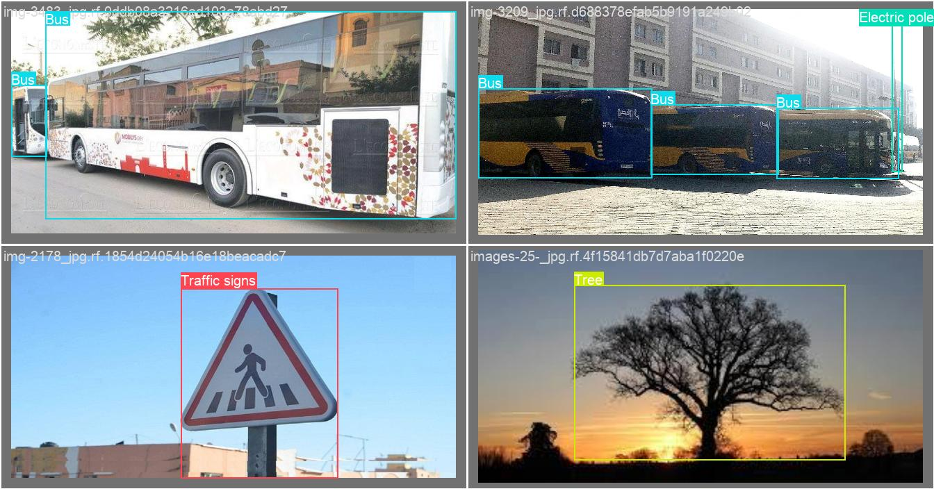
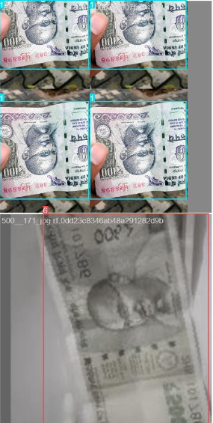
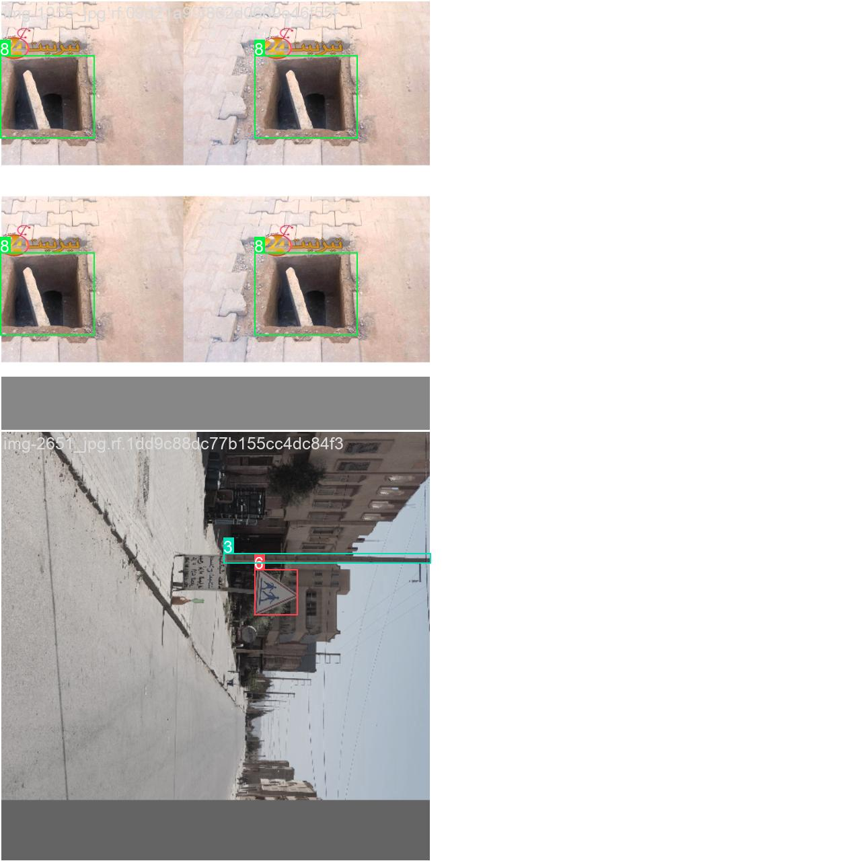
MODULES DESCRIPTION
DATA MANAGEMENT
Collects and stores real-time image data and known face data.
Processes and compares data using YOLO, CNN, and face recognition algorithms.

Slide 14
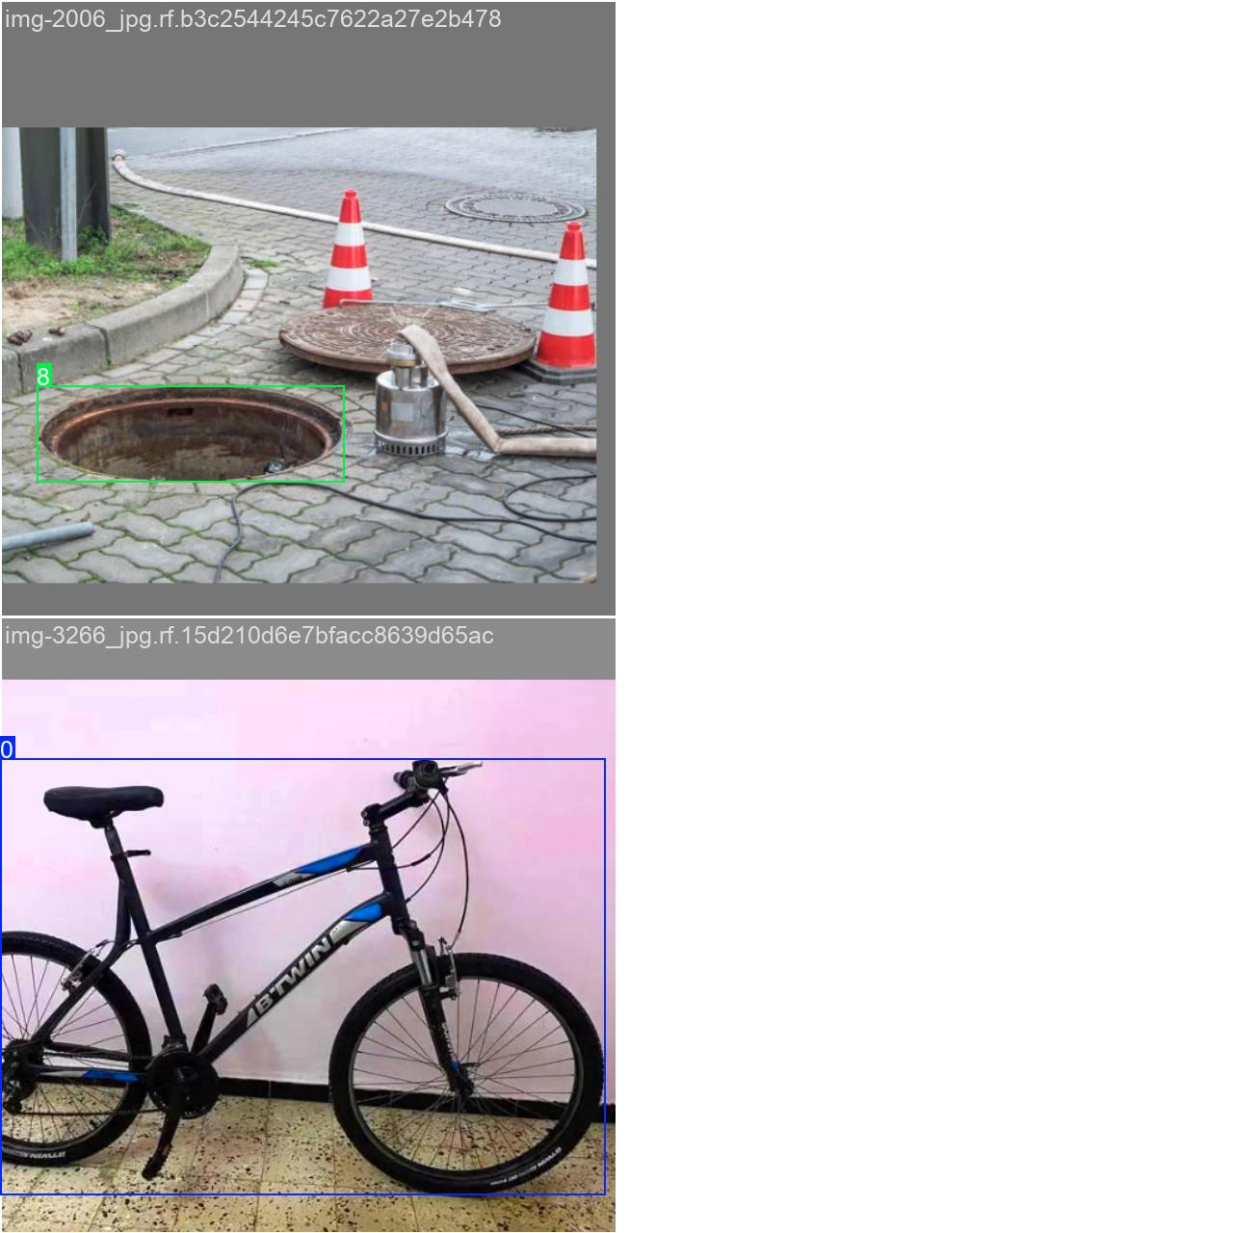
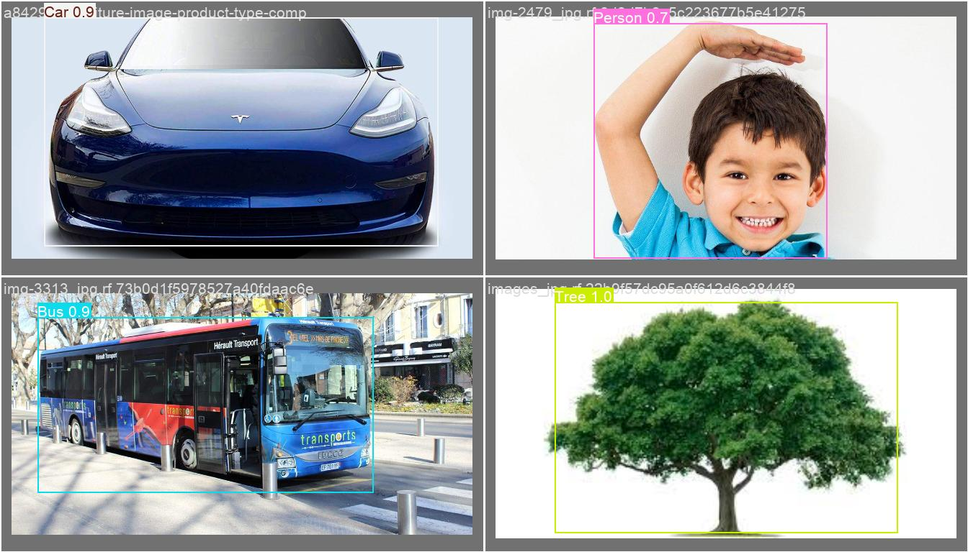
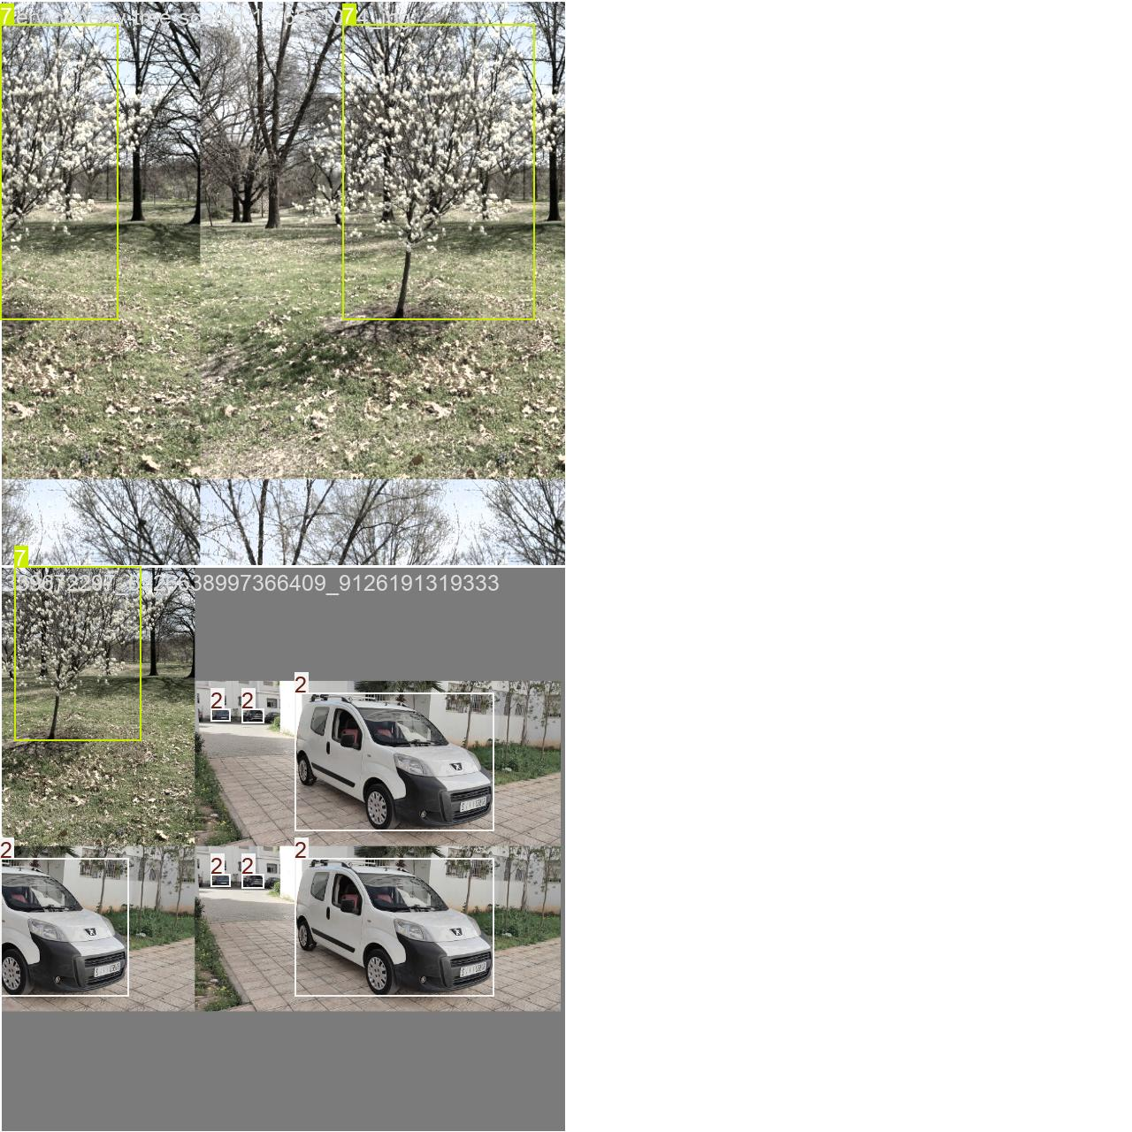
OBJECT DETECTION
Uses YOLOv8 deep learning algorithm for real-time detection.
Identifies and classifies multiple objects with bounding boxes.
Provides detected object names for voice output assistance.

Slide 15
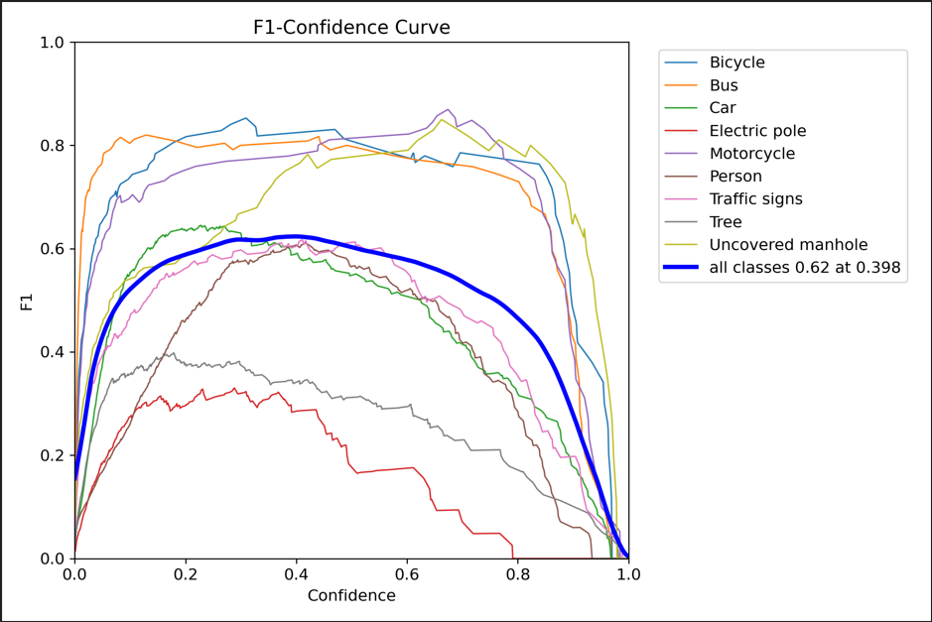

Slide 16
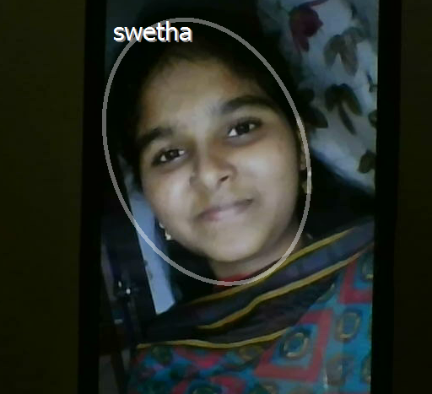
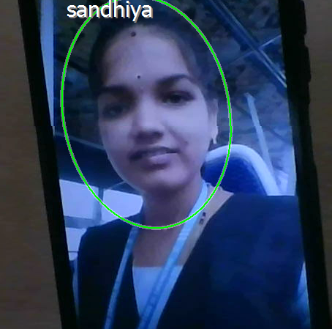
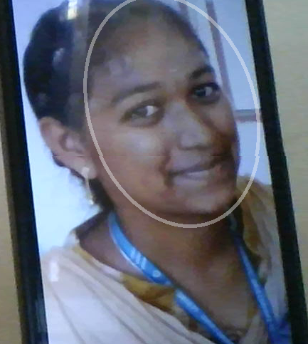
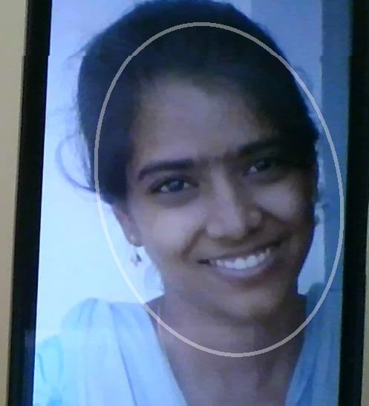
FACE RECOGNITION
Detects faces from real-time camera input.
Uses Grassman algorithm for accurate identification. Extracts important facial features.
Known person
Unknown person

Slide 17
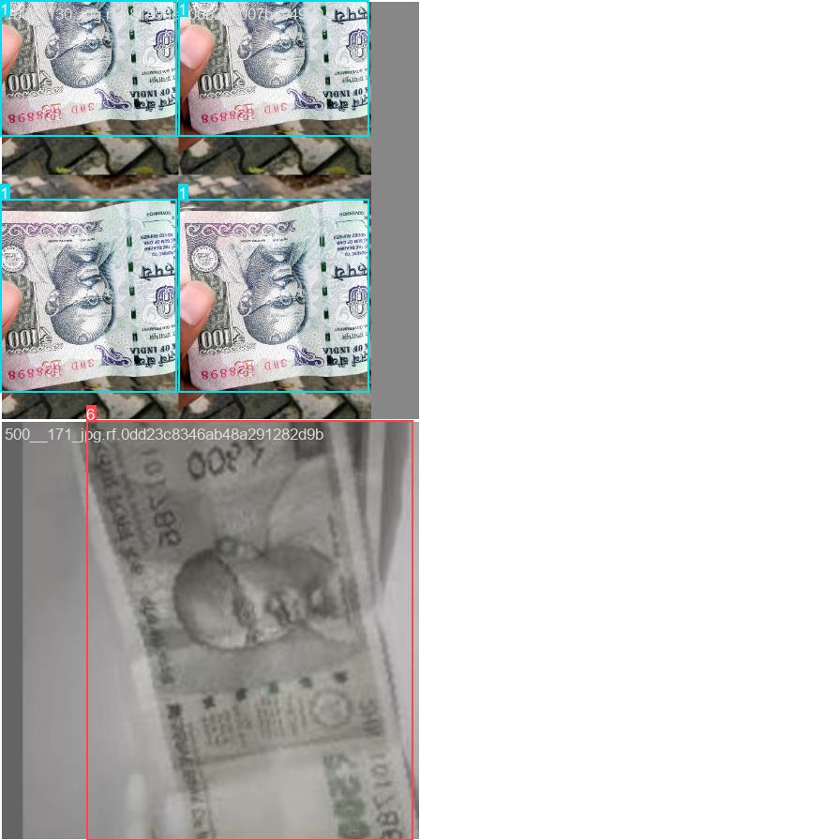
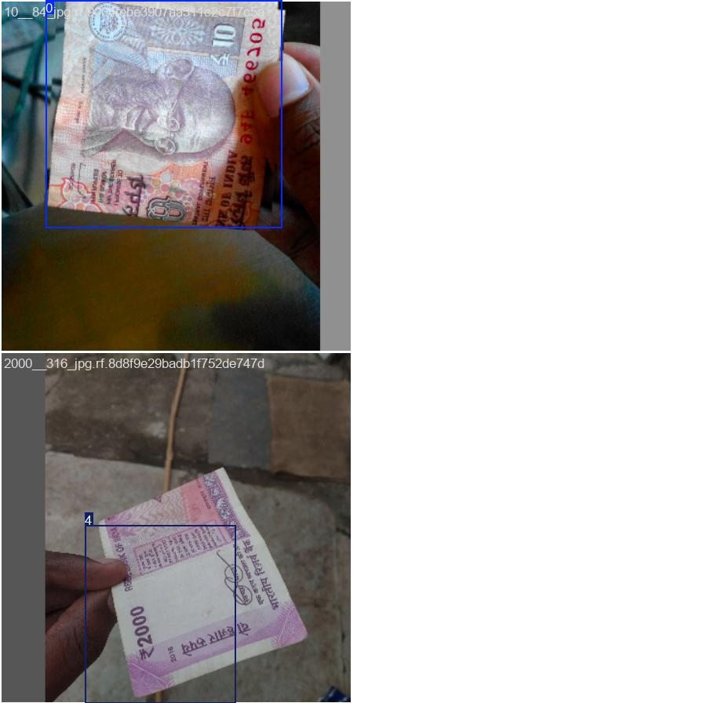
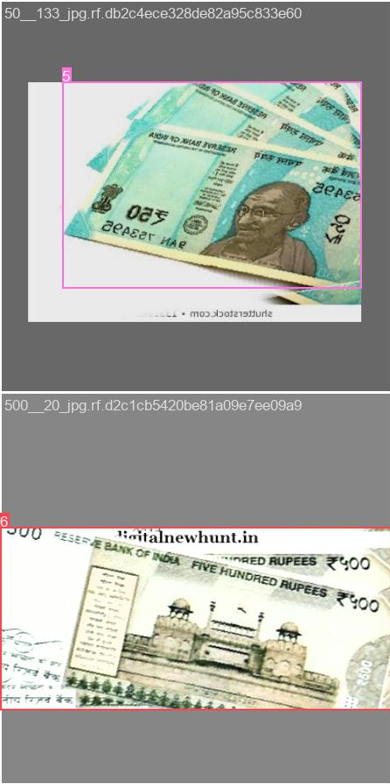
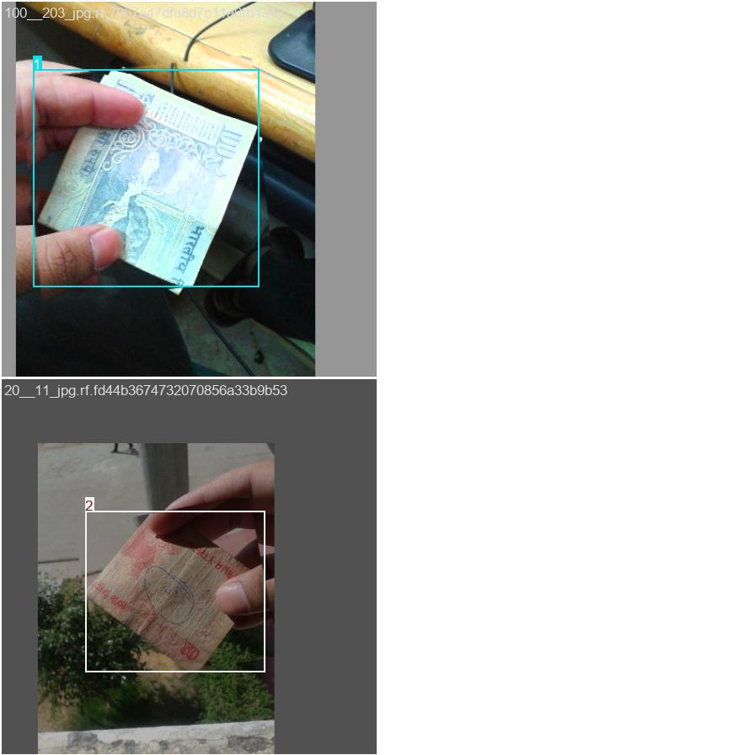
CURRENCY RECOGNITION
Capture the currency note image using a camera.
Uses a CNN for classification. Extracts features like color, number, and design patterns.

Slide 18
AUDIO FEEDBACK
Acts as the main communication interface between the system and the user.
Converts detected results into voice message using Text-to-Speech (TTS)
Provides real-time guidance such as “Obstacle ahead” or “Move left”.

Slide 19
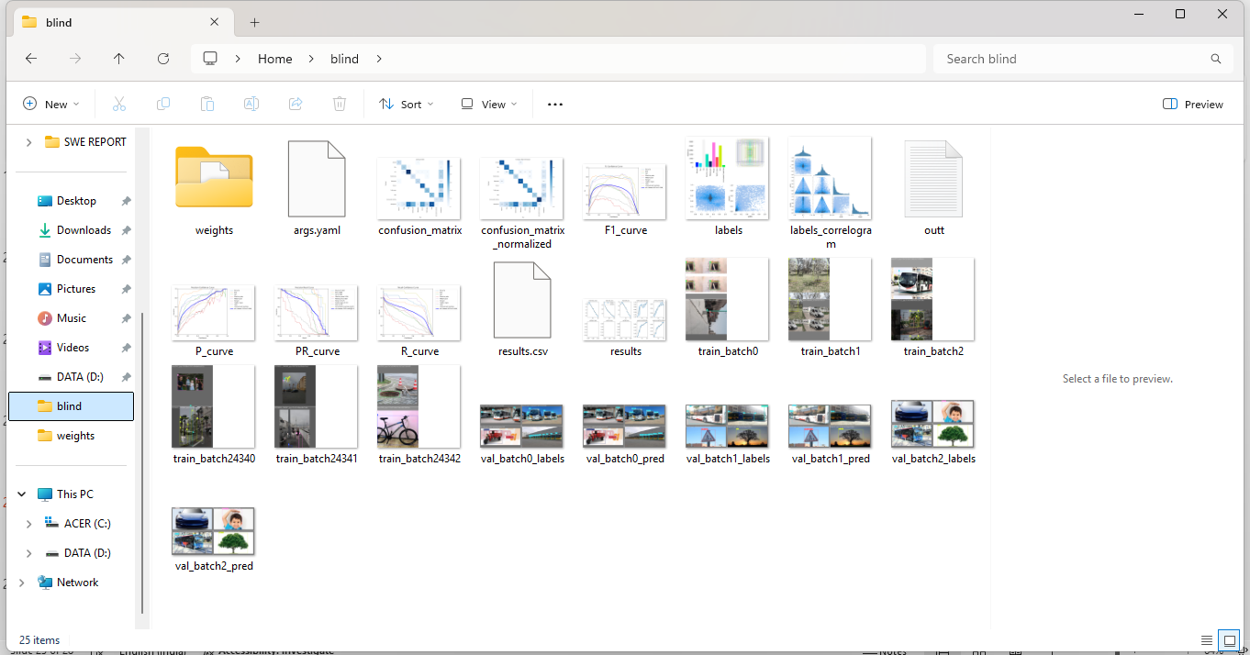
SCREENSHOTS

Slide 20
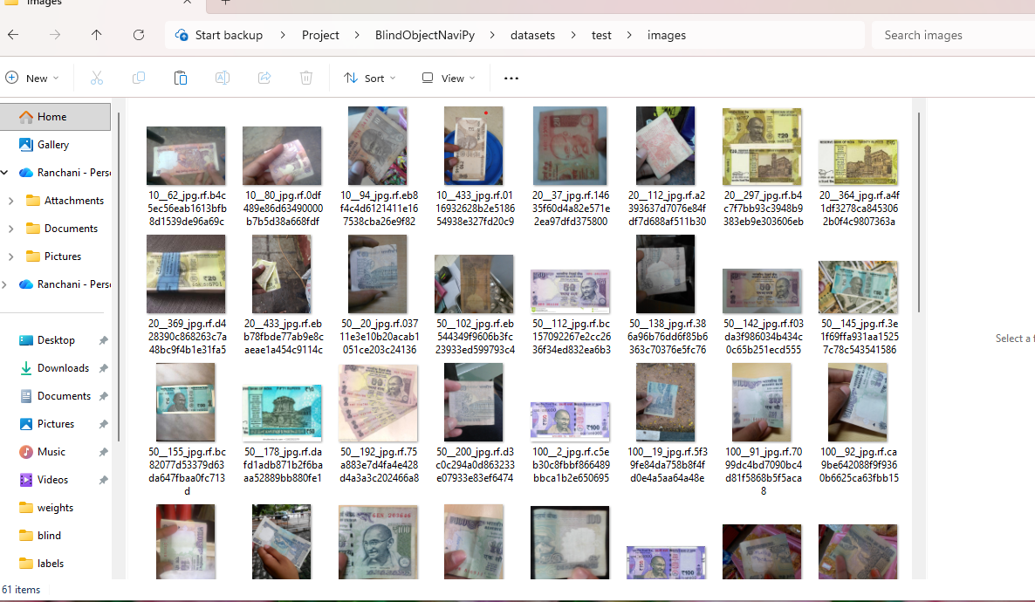

Slide 21
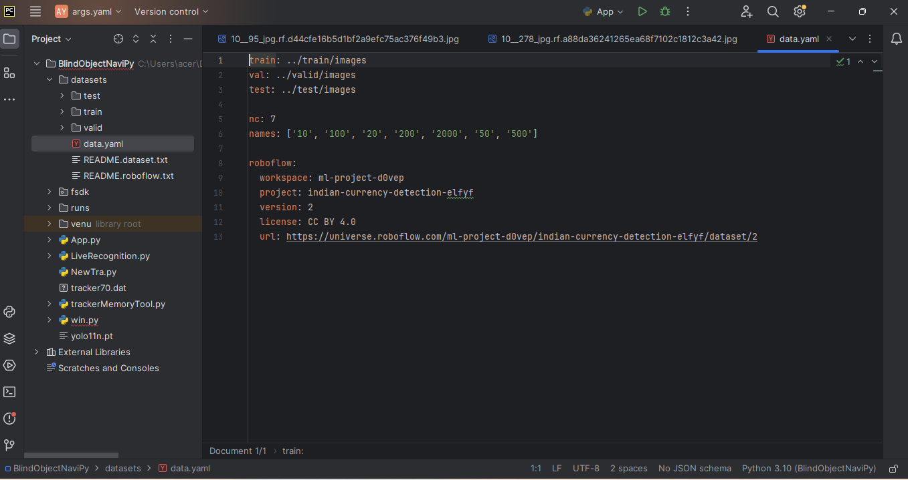

Slide 22
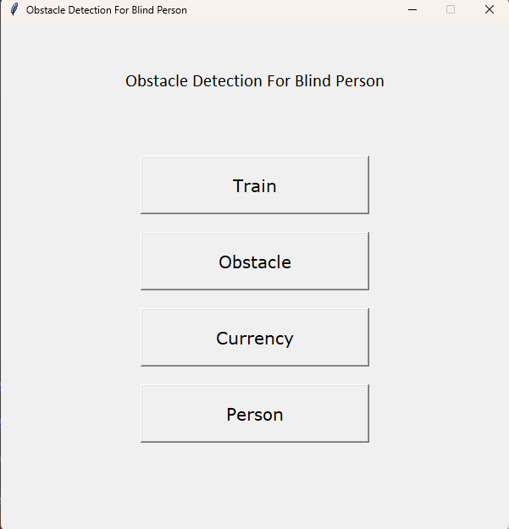

Slide 23
CONCLUSION
Vision aid one provides real-time environmental awareness to support safe navigation.
The wearable design enhances independence, quality of life for visually impaired individuals.

Slide 24
REFERENCES
[1] Rocha, Daniel, et al. "Using object detection technology to identify defects in clothing for blind people." Sensors 23.9 (2023): 4381.
[2] Darshan A, Mirapure, Pakhamode Dipam, and Shirpurkar Rina. "Object detection and recognition using tensorflow for blind people." International Journal of Trend in Scientific Research and Development 8.5 (2024): 747-752.
[3] Reynolds, Jarek, Chandra Kanth Nagesh, and Danna Gurari. "Salient object detection for images taken by people with vision impairments." Proceedings of the IEEE/CVF Winter Conference on Applications of Computer Vision. 2024.
[4] Liang, Wenteng, et al. "Unknown sniffer for object detection: Don't turn a blind eye to unknown objects." Proceedings of the IEEE/CVF conference on computer vision and pattern recognition. 2023.
[5] Kuribayashi, Masaki, et al. "Pathfinder: Designing a map-less navigation system for blind people in unfamiliar buildings." Proceedings of the 2023 CHI Conference on Human Factors in Computing Systems. 2023.

Slide 25
REFERENCES
[6] Dragne, Ciprian, et al. "Distance assessment by object detection—for visually impaired assistive mechatronic system." Applied Sciences 12.13 (2022): 6342.
[7] Shukurov, Jasur. "Improve accessibility for Low Vision and Blind people using Machine Learning and Computer Vision." arXiv preprint arXiv:2404.00043 (2024).
[8] Lee, Dayeon, and Jinsoo Cho. "Automatic object detection algorithm-based braille image generation system for the recognition of real-life obstacles for visually impaired people." Sensors 22.4 (2022): 1601.
[9] Busaeed, Sahar, et al. "LidSonic for visually impaired: Green machine learning-based assistive smart glasses with smart app and Arduino." Electronics 11.7 (2022): 1076.
[10] Janssen, Marijn, et al. "Will algorithms blind people? The effect of explainable AI and decision-makers’ experience on AI-supported decision-making in government." Social Science Computer Review 40.2 (2022): 478-493.

